Slide 1
Power BI Job Simulation Pwc Switzerland

Slide 2
Introduction
This report presents the outcomes and insights gained from completing the Power BI Job Simulation with PwC Switzerland. The simulation provided a hands-on experience that mirrors real-world business scenarios, enabling me to step into the role of a data analyst tasked with transforming raw data into actionable insights.

Slide 3
My Experience
Throughout the program, I was exposed to PwC’s approach to solving client challenges through data-driven storytelling and interactive dashboards. Using Microsoft Power BI, I analyzed customer trends, developed visualizations, and derived actionable insights to improve client decision-making and operational strategies.
This simulation not only strengthened my technical proficiency but also sharpened my ability to align analytics with business needs. Which is an essential skill in today’s data-centric world.

Slide 4
🔄 Task 2: Customer Retention Analysis

Slide 5
Overview
The second task focused on analyzing customer churn patterns to support strategic retention planning. Using Power BI, I transformed raw customer data into a visual narrative that revealed key drivers of attrition and revenue impact.
The objective was to equip stakeholders with insights into churn behavior across demographics, billing preferences, service usage, and subscription history. By identifying at-risk customer segments and high-impact variables, the dashboard enabled data-driven strategies for targeted interventions, personalized engagement, and long-term loyalty growth.

Slide 6
📚 Dataset Introduction
The dataset used for this analysis focuses on customer retention and churn behavior, comprising approximately 162,000 records and 23 attributes. Each row captures detailed information about individual customers, offering a comprehensive view of user demographics, service usage, billing preferences, and engagement history.
Key features of the dataset include:
Customer ID – Unique alphanumeric identifier for each customer
Gender – Categorical attribute: Male or Female
Senior Citizen – Binary indicator of age group (0 = No, 1 = Yes)
Payment Method, Monthly Charge, Total Charge – Billing details used to assess revenue impact
Paperless Billing – Indicates if the customer has opted for paperless communication
Number of Technical & Admin Tickets – Reflects support engagement level and possible service issues
Churn – Target variable indicating whether a customer has discontinued the service

Slide 7
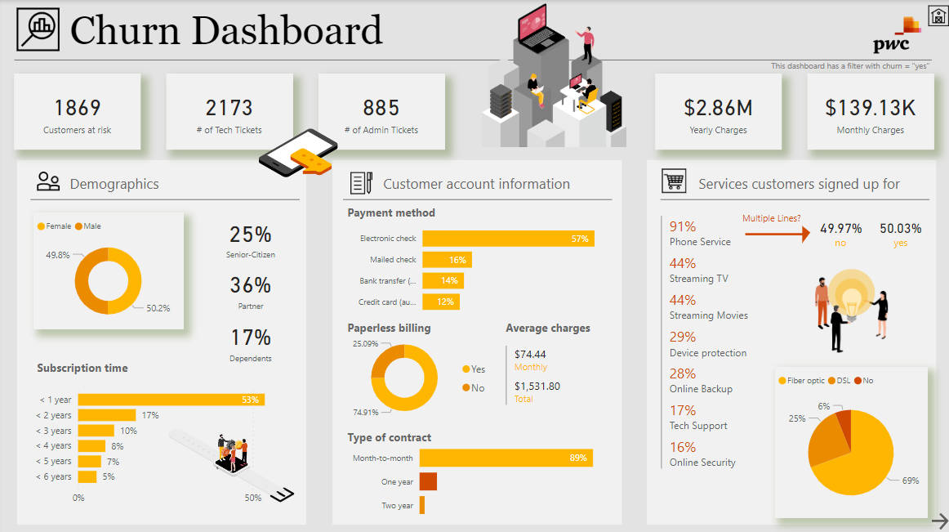
Dashboard

Slide 8
📊 Key Insights from Churn Dashboard
High-Risk Segment Needs Attention
1,869 customers are currently at risk of churning—a critical segment for immediate retention efforts.
Most customers (53%) have been subscribed for less than a year, signaling low tenure as a churn trigger.
Revenue Impact & Billing Patterns
Yearly charges total $2.86M, with an average monthly charge of $74.44.
89% of contracts are month-to-month, often linked to higher churn propensity.
57% of users pay via electronic checks, which may correlate with lower customer loyalty compared to credit-based payments.

Slide 9
📊 Key Insights from Churn Dashboard
Service & Support Trends
High volume of support activity: 2,173 tech tickets and 885 admin tickets suggest potential friction points in the customer journey.
Only 17% of customers use tech support, hinting at underutilized or ineffective support channels.
Demographic Red Flags
25% of customers are senior citizens, a group possibly requiring more tailored service and communication.
Only 17% have dependents and 36% are partners, suggesting a younger, more mobile customer base that may be harder to retain.
Product Adoption Gaps
While 91% have phone service, add-ons like online security (16%) and tech support (17%) have low penetration—potential upsell opportunities.

Slide 10
✅ Recommendations for Stakeholders
Launch proactive retention campaigns targeting the 1,869 high-risk customers—prioritize those with month-to-month contracts and low tenure.
Promote long-term contracts through personalized offers or incentives to reduce churn volatility.
Revamp support services by investigating pain points indicated by high support ticket volume—optimize resolution time and quality.
Reassess billing preferences and explore smoother alternatives for users paying via electronic check, potentially linked to lower retention.

Slide 11
✅ Recommendations for Stakeholders
Upsell underutilized services like online security and tech support to increase customer stickiness and perceived value.
Tailor engagement strategies for senior citizens and single-person households with focused communication and service bundles.
Use churn insights in pricing decisions, balancing monthly charge competitiveness with retention impact.

Slide 12
Thank You

